Slide 1
ENGINEERING MECHANICS GRADUATE PROGRAM
Purchasing and Travel Procedures
Melissa Nipper, BEAM Business Services Coordinator

Slide 2
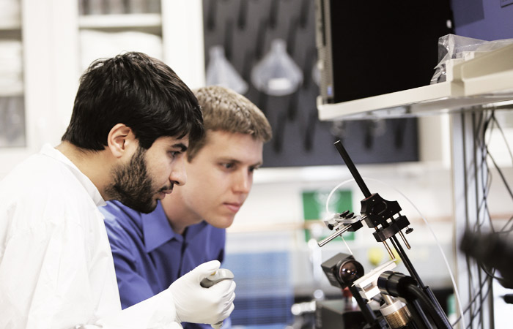
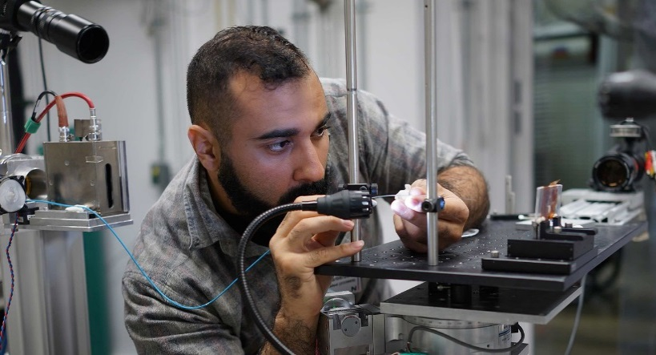
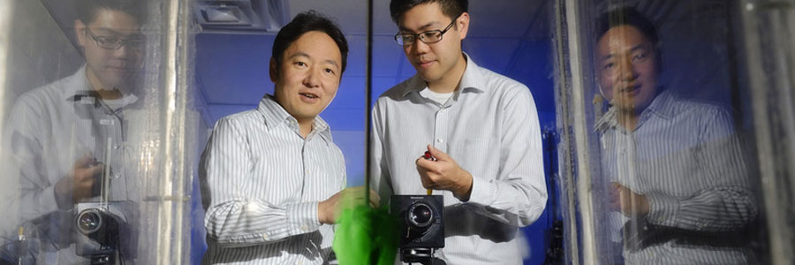
Purchasing Procedures
If you are working on a research project funded through a grant or contract, your Advisor may wish for you to purchase laboratory supplies for research.
Purchasing can be done through the university’s procurement system or by personal purchase with request for reimbursement.

Slide 3
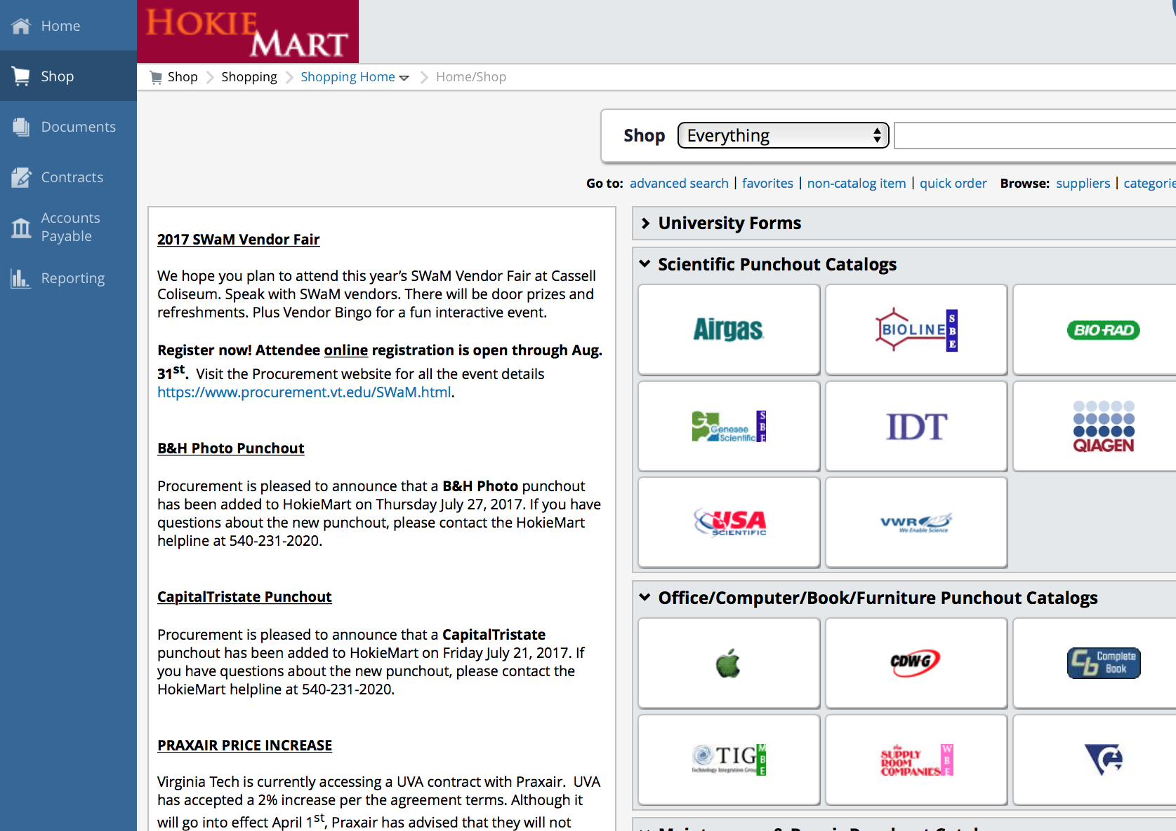
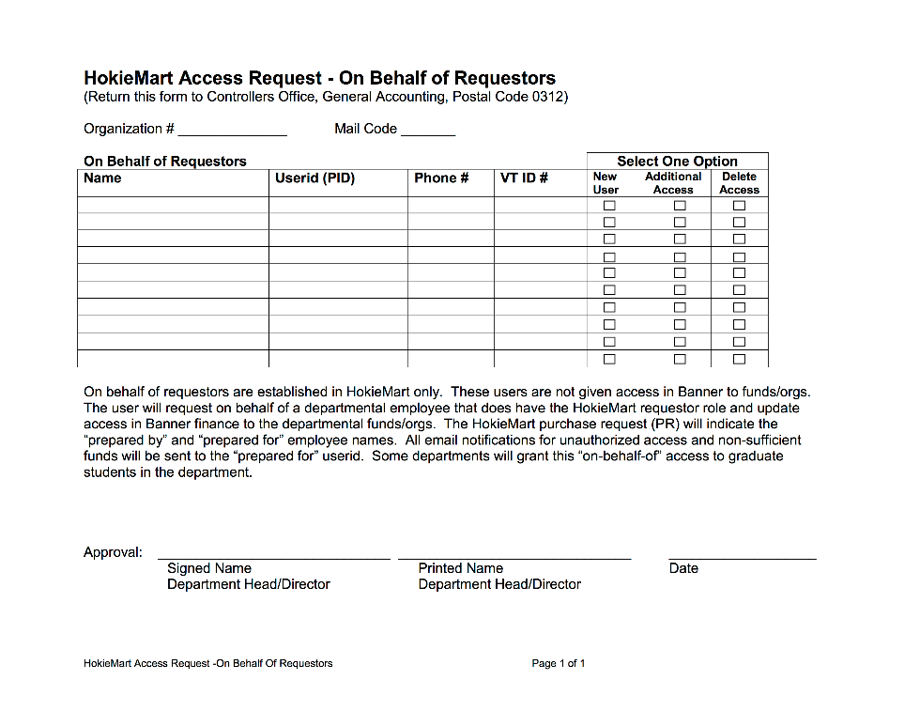
Complete HokieMart Access Form www.hokiemart.vt.edu
Visit your Fiscal Technician to complete a form for access!

Slide 4

How are Orders Placed?
HokieMart is the university’s e-Procurement (purchasing) system for the for placing orders with internal service centers and external suppliers.
All orders are to entered in as a requisition into the HokieMart system.
Purchasing system will generate a purchase order that is faxed/electronically sent to suppliers for processing.
Any order confirmation received by suppliers via email will be forwarded to team member requesting orders.
Requestors are responsible for contacting suppliers regarding order status, fulfillment problems, and returns.
REMEMBER that all packing slips from shipments must be turned into the department’s Fiscal Technician as soon as possible so that payment can be released to the suppliers. Can also send scanned email of packing slip.
If no packing slip is available, please make sure to email us (with information on the vendors name and number of purchase order) to confirm which items were received.

Slide 5
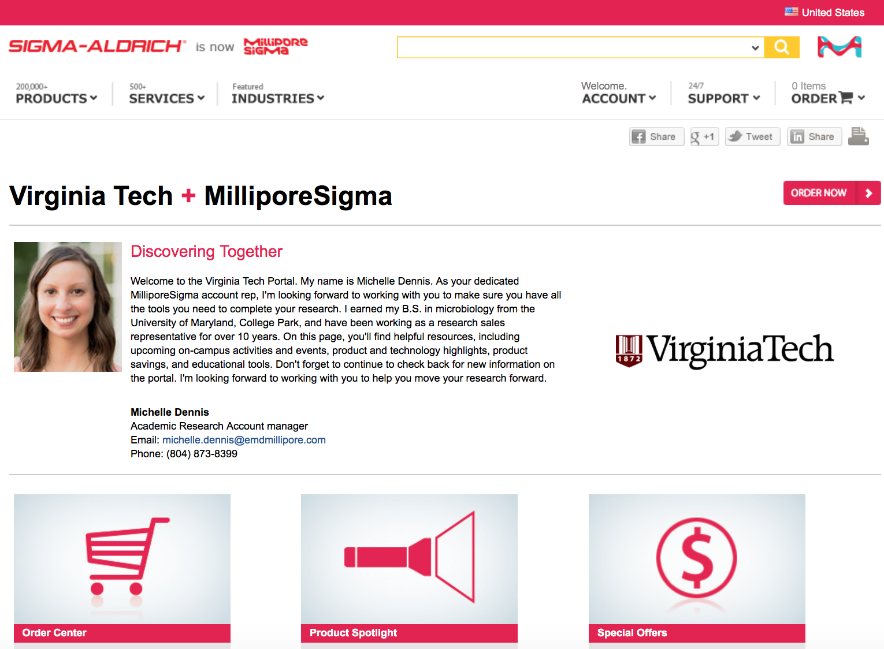
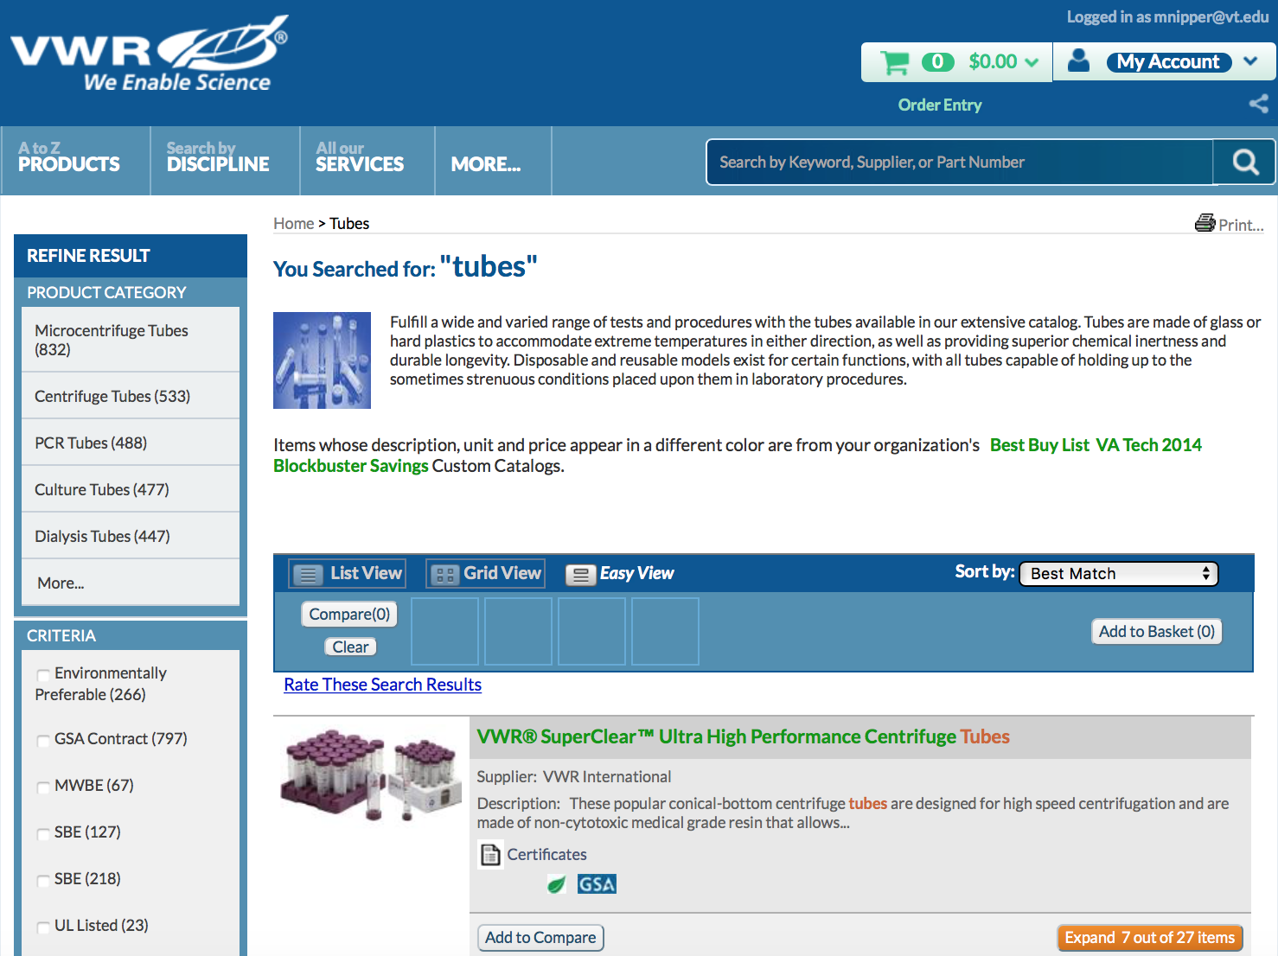
Punchout Catalogs Purchases
Notes:
`

Slide 6
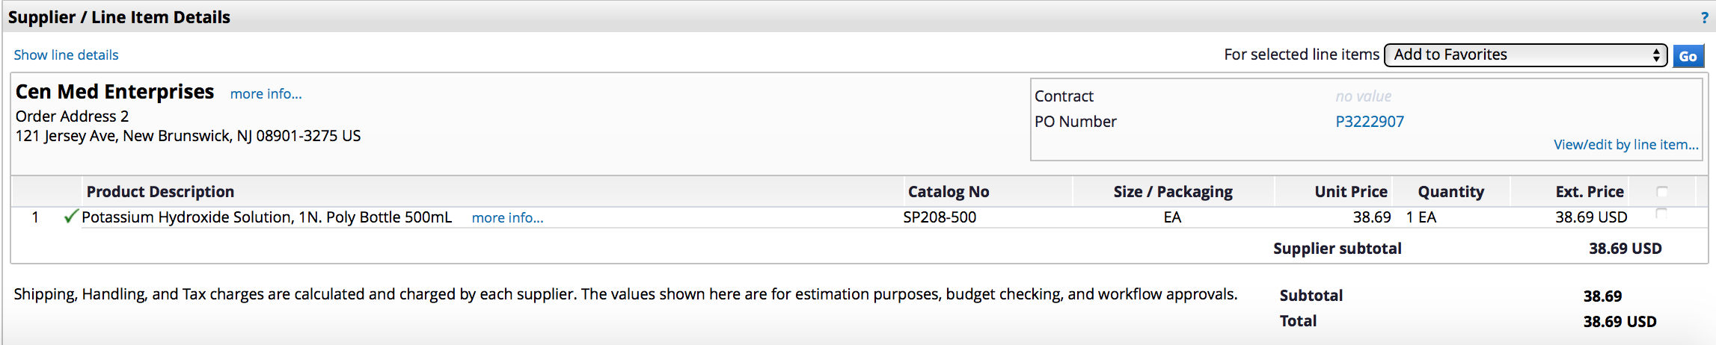
Non-Catalogs Purchases
Notes:
`

Slide 7
Reimbursement Requests
All in store purchases
Online transactions using personal credit card (e.g. Amazon, and other vendors who may not accept purchase orders)
Complete a Reimbursement Request Form and submit it along with your receipts to your advisor’s support staff. Be sure to consult with your advisor for approval before purchasing supplies with your own funds.
Can turn in collection of receipts as long as they are within 30 days of purchase.
You must provide proof of payment on all receipts submitted for reimbursement.

Slide 8
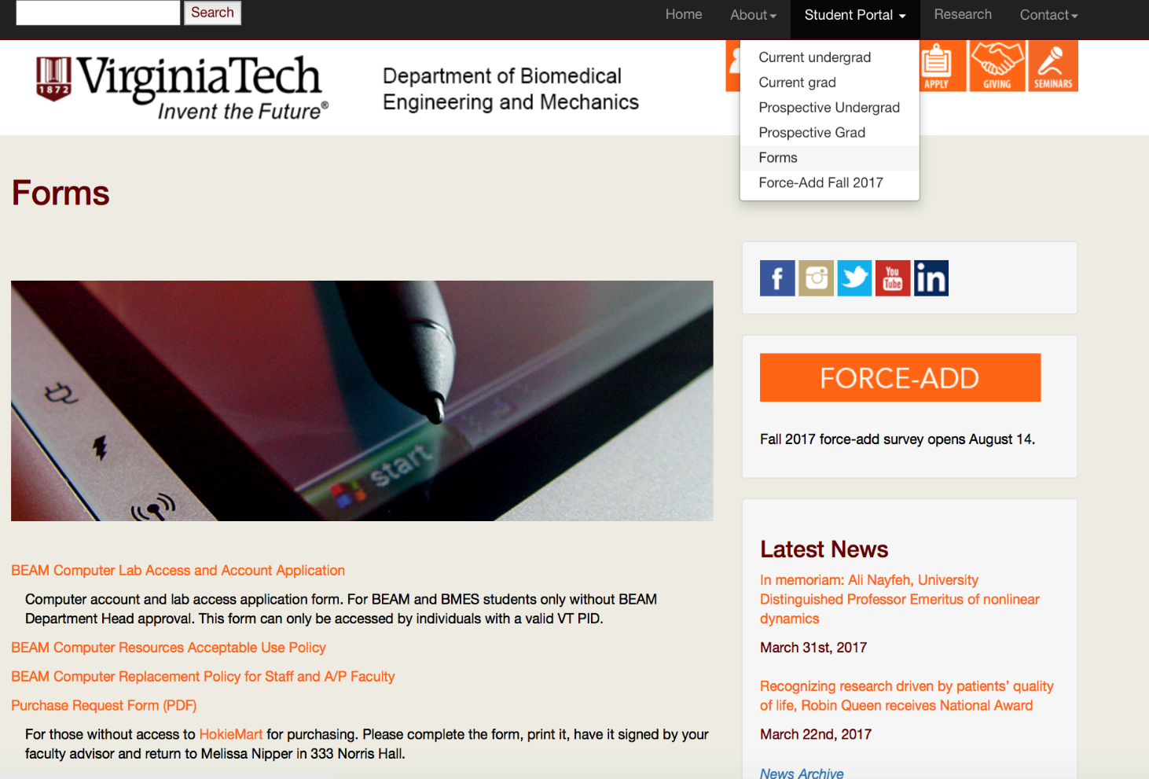
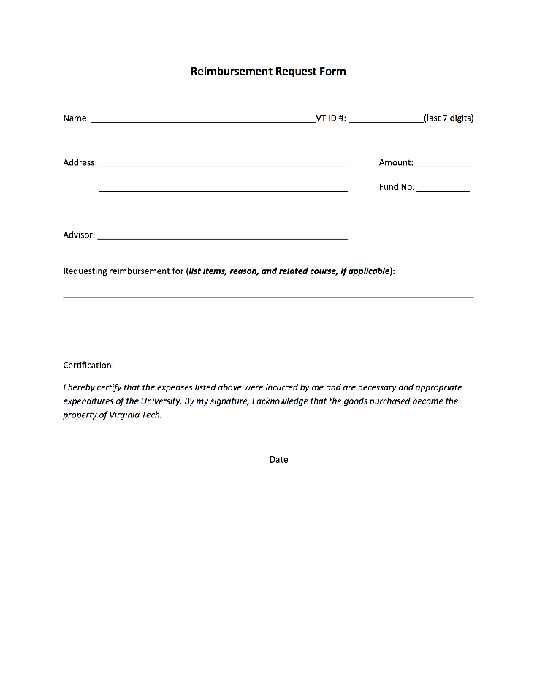
Complete Reimbursement Request Form http://www.beam.vt.edu/about/forms.php
Can also access fillable form on BEAM website!
Notes:
Accessible through your home department webpage, Department of Biomedical Engineering and Mechanics website.

Slide 9
Sample Receipts for Reimbursement
Receipts showing proper proof of payment from the purchaser:

Slide 10
BEAM Machine Shop Orders
One of several internal service centers on campus established for the purpose of providing goods and services to university departments.
Steps to requesting shop work:
First visit Laboratory Instrument Maker, Darrell Link, to discuss hourly rate and estimated time required to complete your machining needs. REMEMBER: All dimensions must be provided in inches/feet; not metric.
Complete a Interdepartmental Service Request (ISR) in HokieMart, or have your advisor’s program support staff submit one for you.
Machine Shop will contact you once work has been completed.
**Shop will not begin work on your job until official ISR is received from department.**

Slide 11
Frequently Asked Questions:
What’s the benefit in purchasing my laboratory supplies through HokieMart vs. purchasing it myself and requesting reimbursement?
Purchases through HokieMart will be tax exempt and at very low shipping costs, which will save research dollars. Most orders will include supplier negotiated rates and academic discounts.
What if we are interested in purchasing from a supplier not listed in HokieMart?
Most of the supplies you will need for your research will be available through one of our many vendors listed in the HokieMart. However, if you find that there is a product not available through any of the suppliers listed, it is possible (if the vendor accepts POs/payment terms) to add them as a new supplier. Instructions for this process will be made available to you after your training.

Slide 12
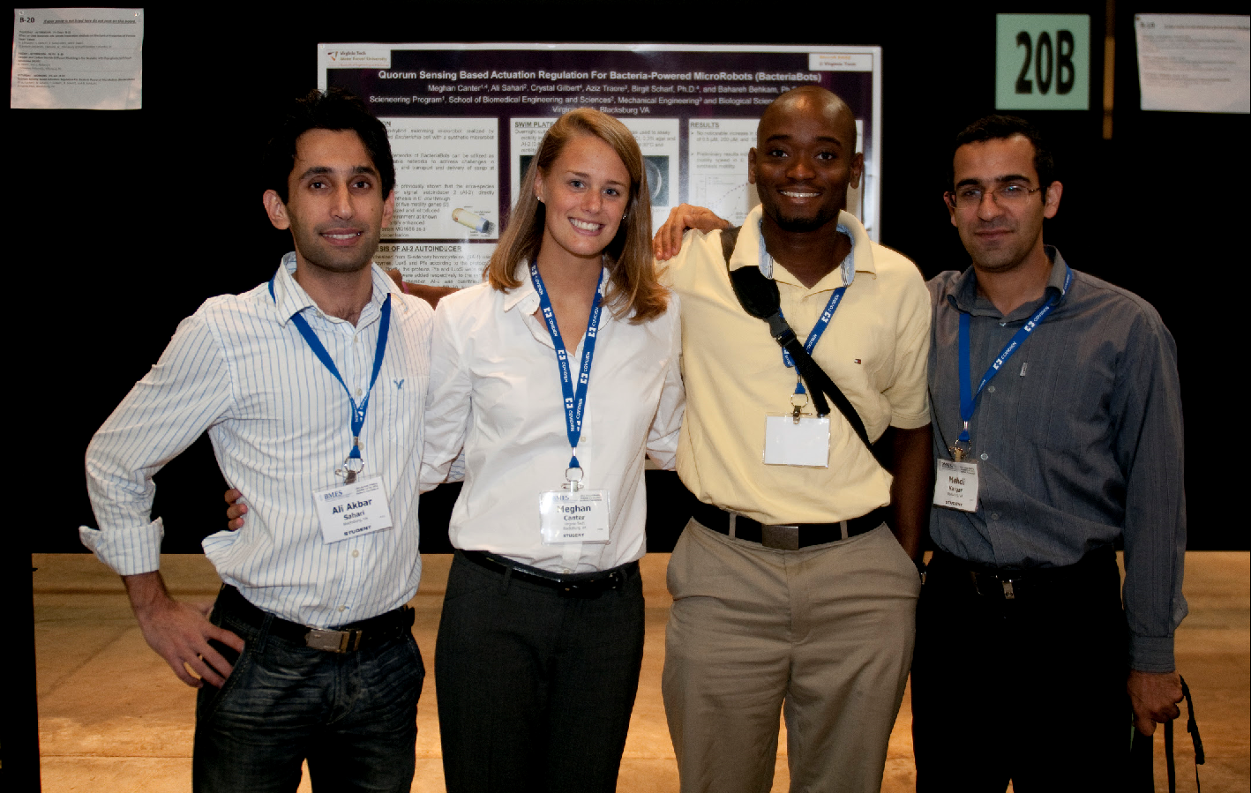
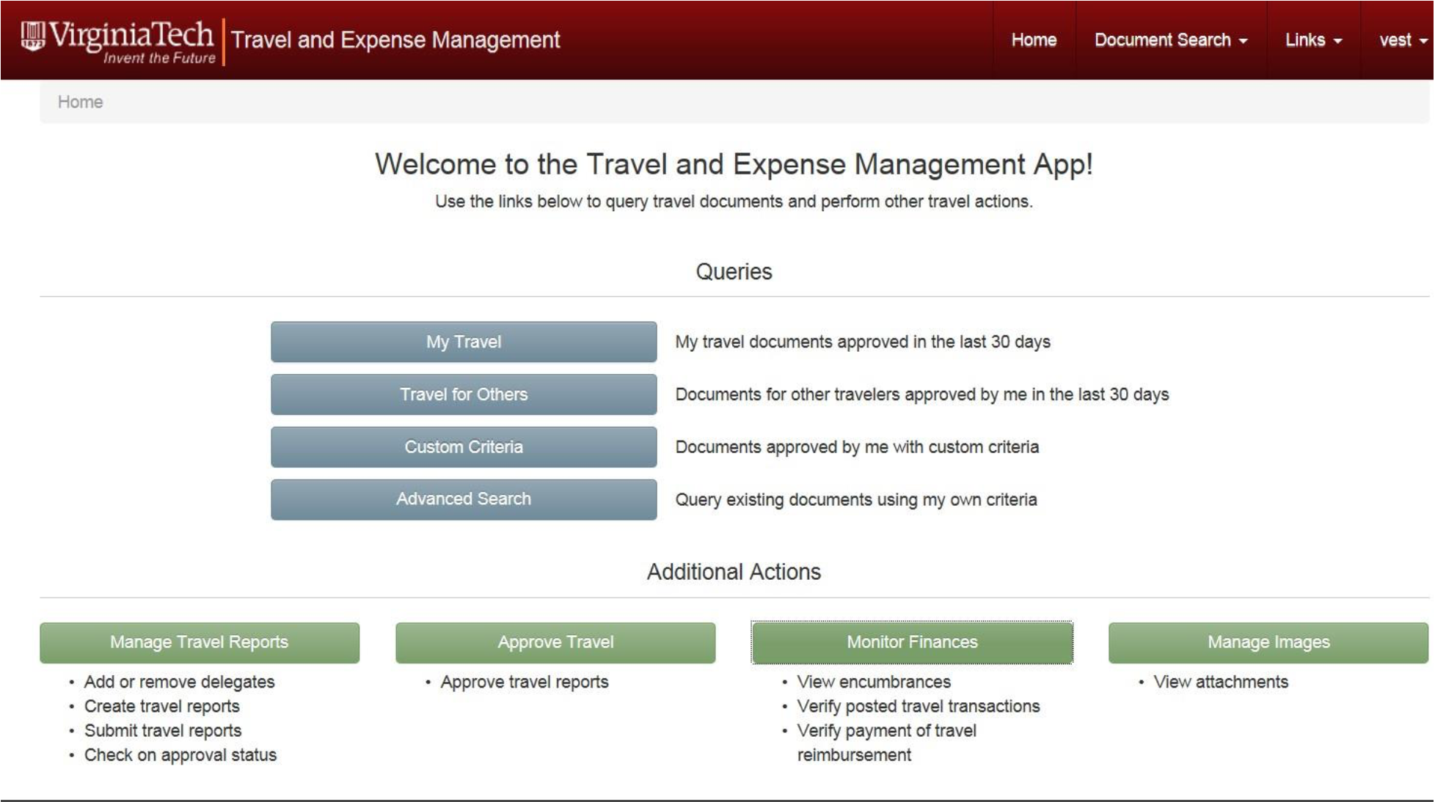
Travel Procedures
https://webapps.es.vt.edu/travel
If preparing to travel to present research, conduct experiments or any other purpose to conduct business on behalf of the department, you must complete a Travel Authorization in the Travel & Expense Management System (TEM).
Notes:
ALL travelers (including presenters, students, visitors, and other business associates) whose travel expenses are to be charged to university public funds are encouraged to prepare an estimate of the total cost of any proposed travel (travel authorization). Total cost includes lodging, meals, conference registration, airfare, and any other travel costs or course fees.

Slide 13
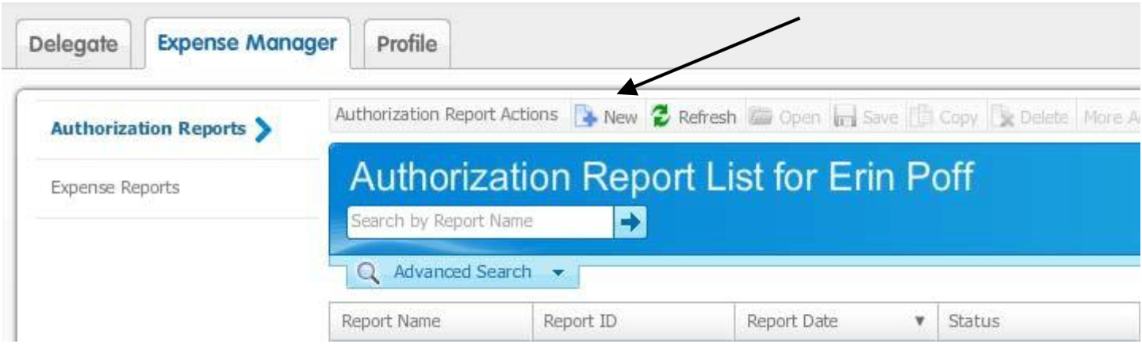
Travel Authorization
The travel authorization should include both reimbursable and non reimbursable expenses (only reimbursable expenses are encumbered into research fund’s budget). Both reimbursable and non-reimbursable expenses can be entered so that the total cost of the trip can be captured. This is an important step before preparing for any travel to get proper approval from the department.
  Select the applicable traveler from the Delegate screen
  Select the "Expense Manager" tab
  Select the "Authorization Reports" tab in the left pane
  Select the "New" icon in the tool bar, which opens a window titled "Create New Report"

Slide 14
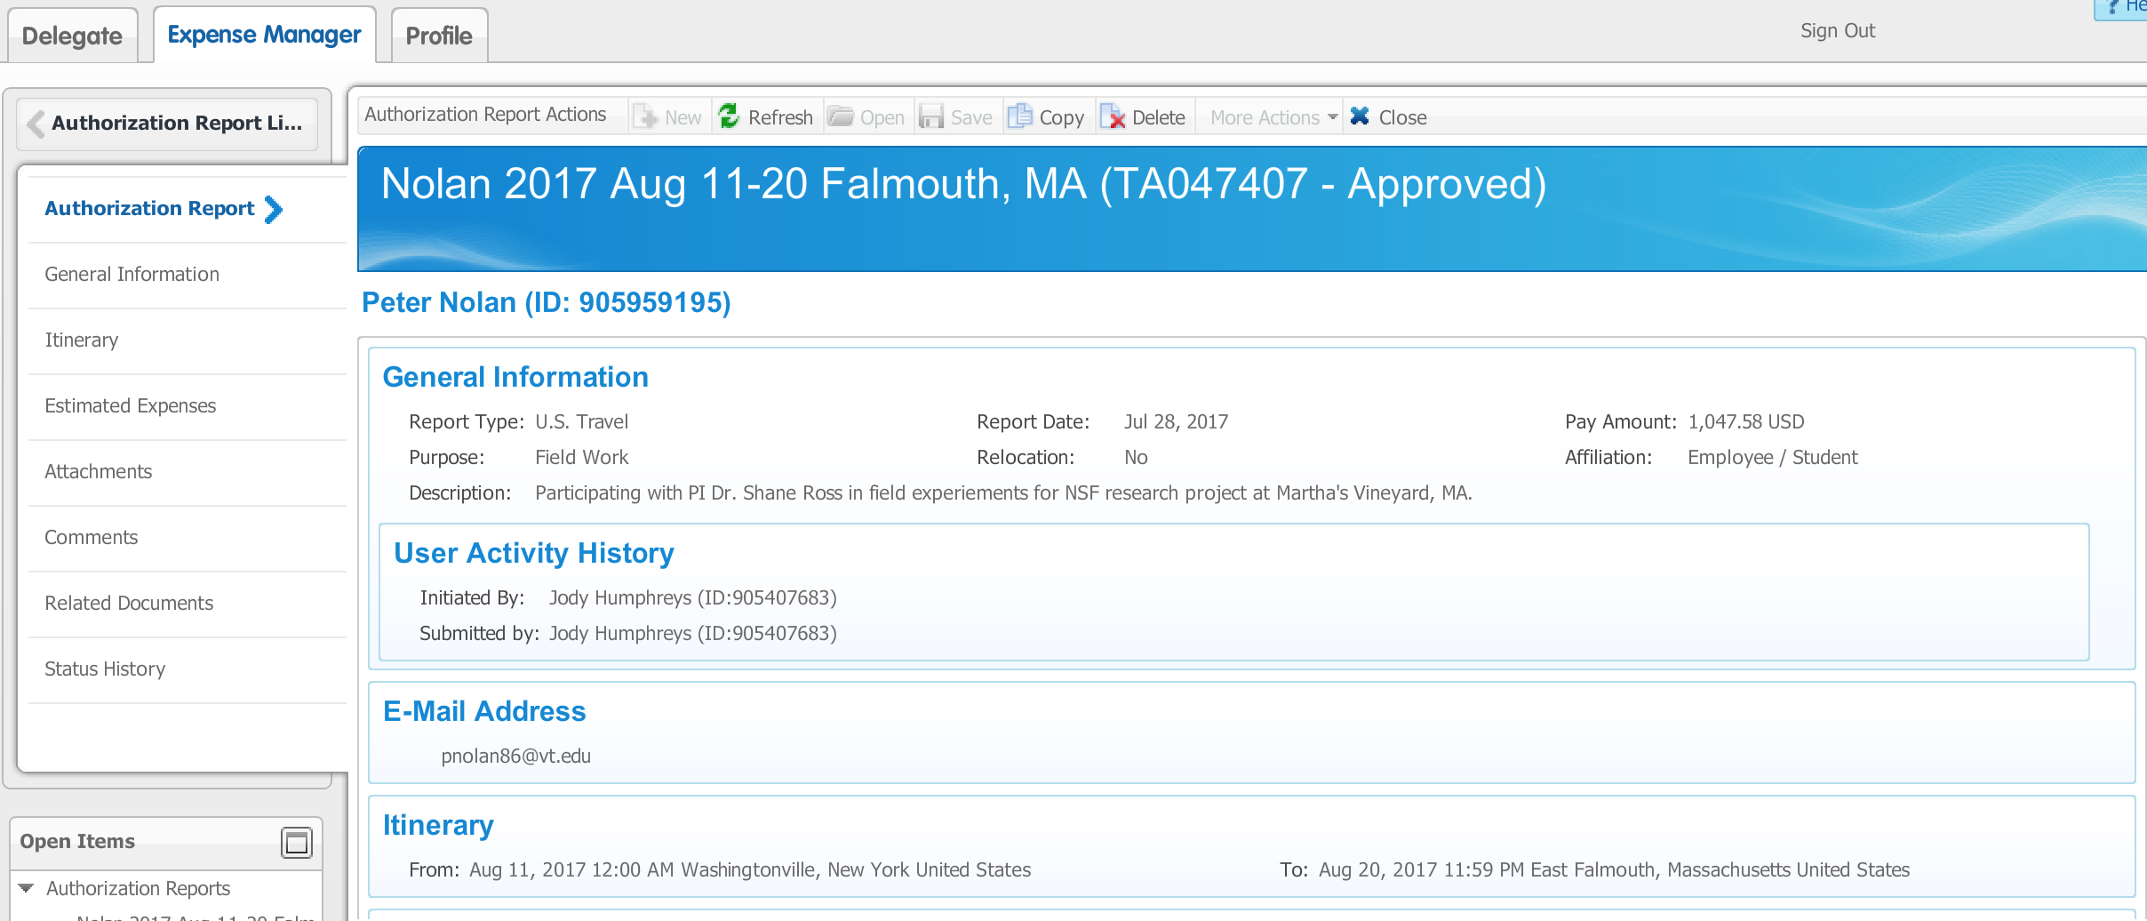
Travel Authorization (TA)
Reimbursable expenses are items that the traveler will be reimbursed for directly, such as personal car mileage, meals, hotel, parking and tolls. Expenses must be itemized by date of travel. Do not combine expenses for multiple days under one date.
Non-reimbursable expenses are items that are paid directly by the university to a vendor on behalf of the traveler, such as a registration fee or airline ticket. If disallowed expenses will be included on the travel report, they should be entered with the “Paid By” of “Nonreimb-Disallowed” category.

Slide 15
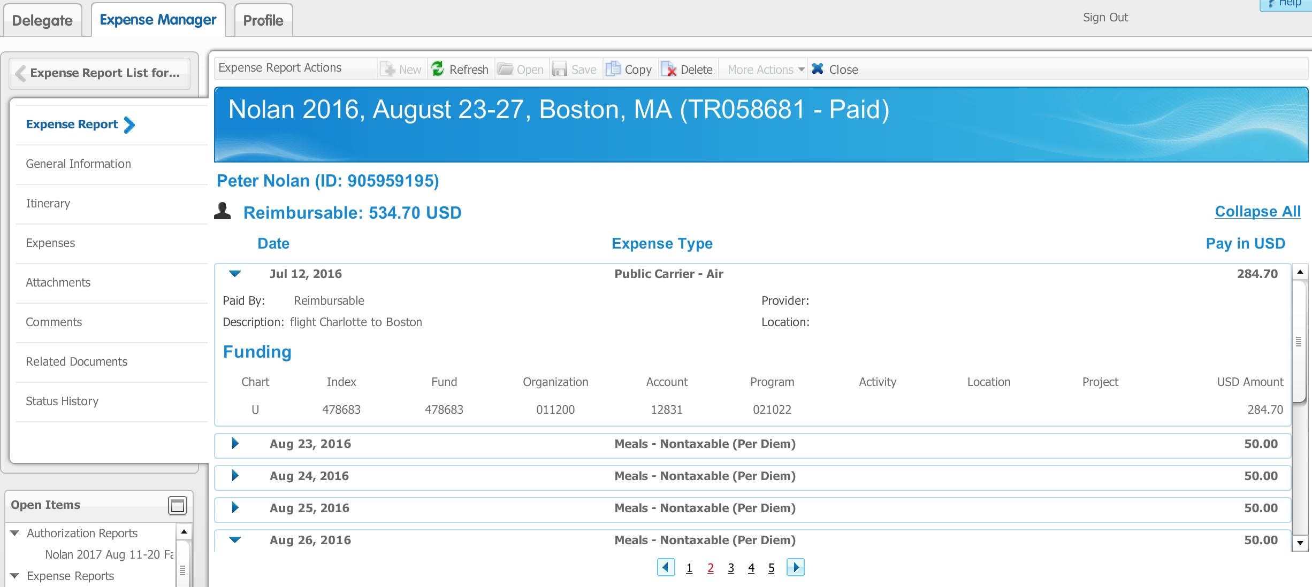
Travel Reimbursement (TR)
To create a TR report from a TA report, select the delegate assignment for the applicable traveler, then select the "Expense Manager" tab at the top. A list of all the TAs for the traveler will display. Select the applicable TA by highlighting it, and then select the button at the bottom "Generate Expense Report".

Slide 16
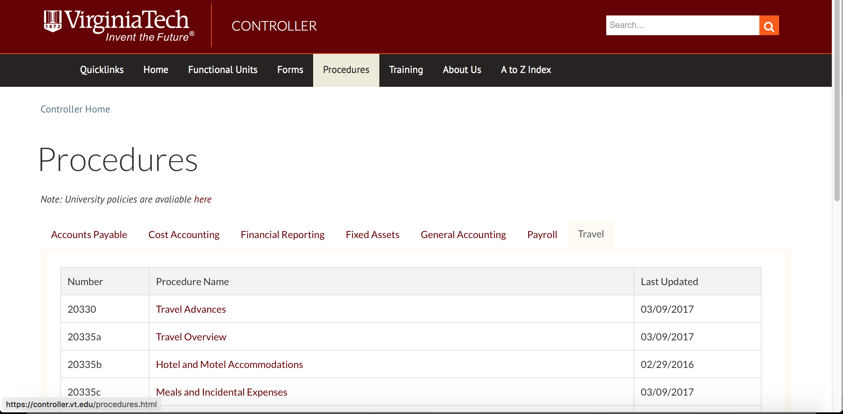
Travel Procedures and TEM Manual
Procedures and step-by-step instructions for the Travel & Expense Management System (TEM) can be found on the Controller’s website.

Slide 17
Any Questions?
        Melissa D. Nipper, Business Services Coordinator
        Department of Biomedical Engineering
        and Mechanics
        Norris Hall, Room 333-B,
        Office: (540) 231-5957
        mnipper@vt.edu

